Slide 1


Data Science Portugal
#41
Data Science with a Visual Beat
October 23th, 2018 - Porto
Notes:
Welcome to Data Science Portugal #36
Community of Data Science enthusiasts
Cover different topics, technologies and business areas
Who’s attending for the first time?
Who isn’t from Porto?

Slide 2
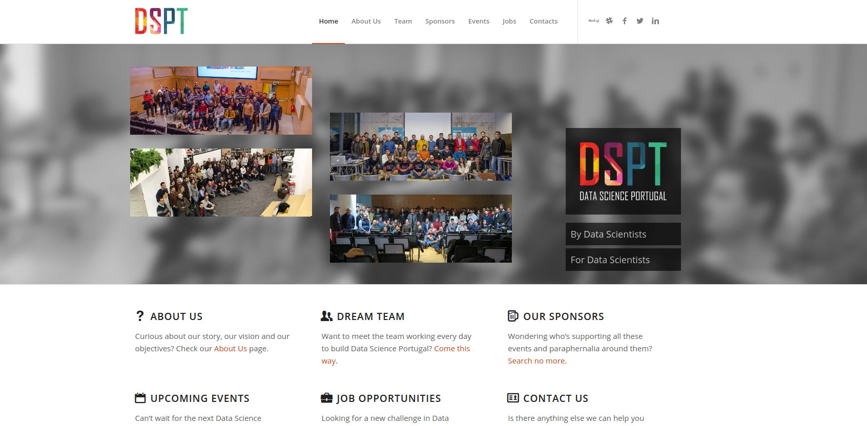
https://www.datascienceportugal.com
Notes:
Falar da Secção de Jobs e Eventos para ser colaborativo

Slide 3
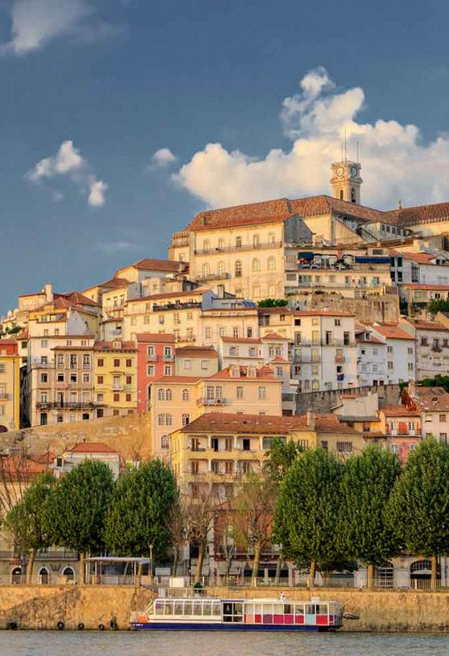
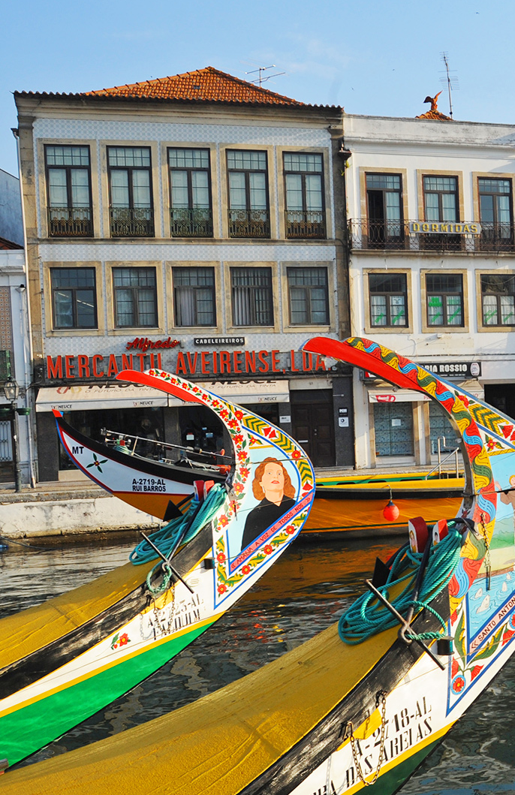
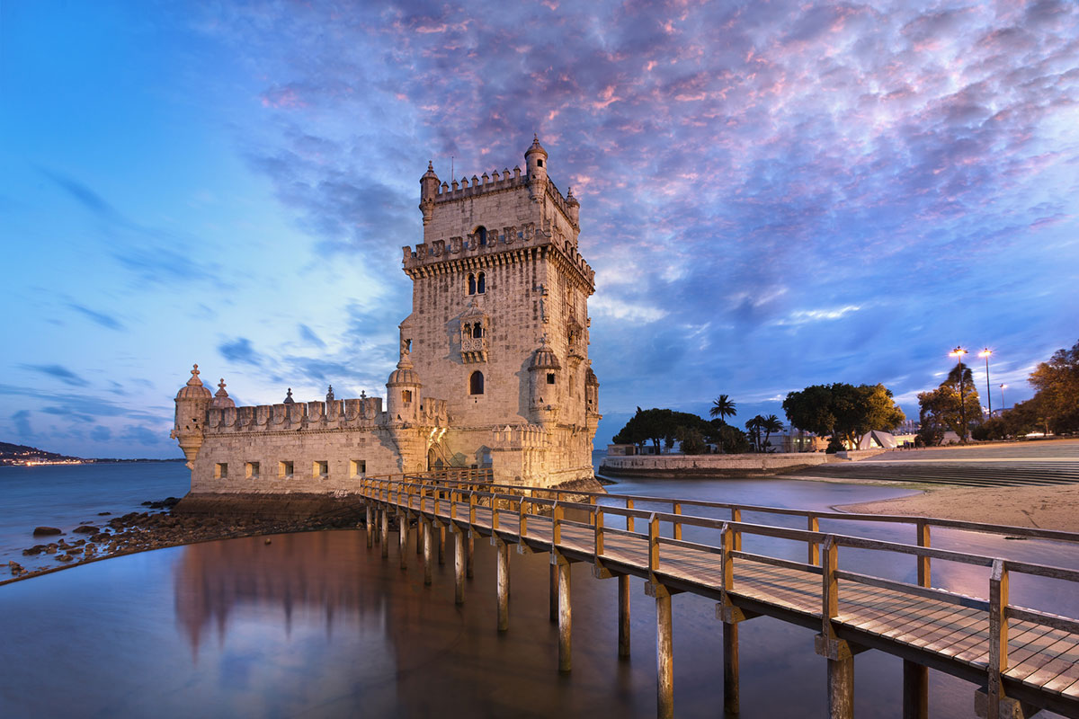
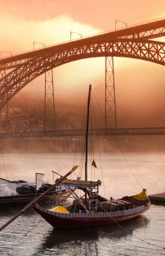
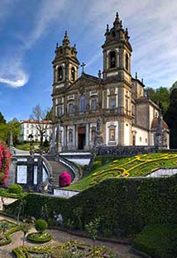
Where are we?
COIMBRA
AVEIRO
O
LISBOA
PORTO
BRAGA
Notes:
Vamos ter meetup no Porto segunda no Uptec

Slide 4




Our channels
1400
1400
1200
400

Slide 5
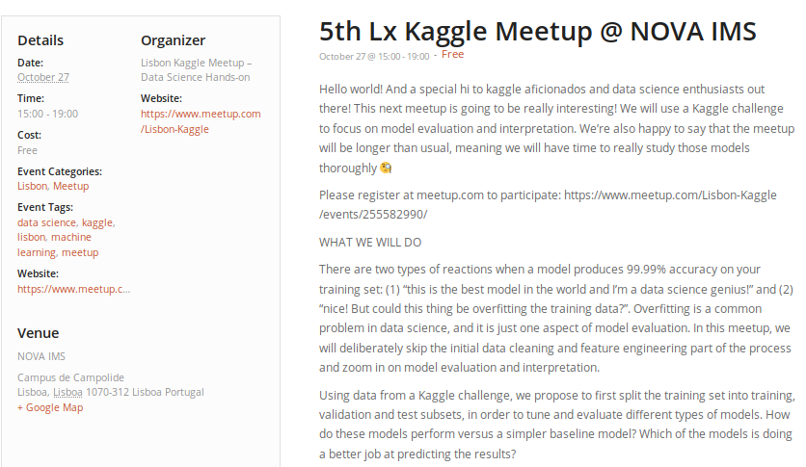
DSPT Events
Notes:
TODO: colocar info sobre o speaker?

Slide 6
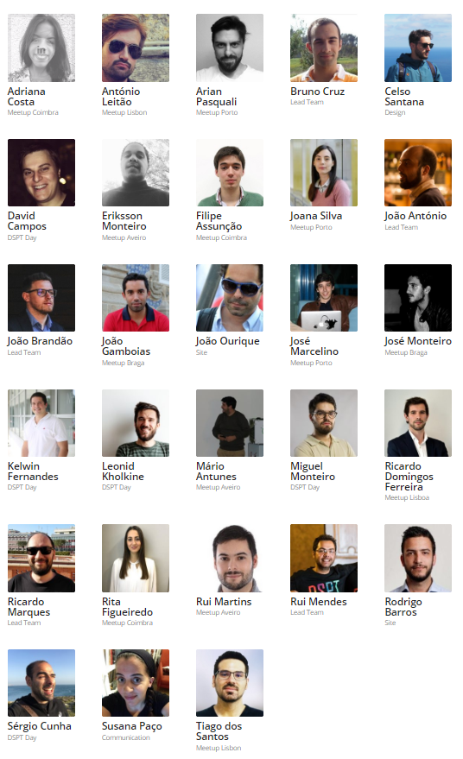
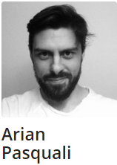
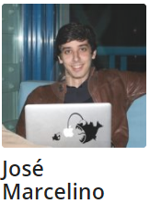
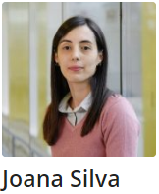
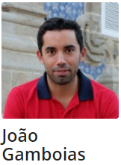
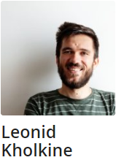
Team (Meetup Porto)

Slide 7























info@datascienceportugal.com
‹#›
Notes:
We’re independent but need help to continue our activities
Sponsor and support from external entities and companies
These are the entities that help us with coffee break sponsoring, space for meetups or both
If you’re interested, contact us at info@datascienceportugal.com
Soon we’ll launch a plan for long term partnership with DSPT (rather than pontual help)

Slide 8
The DSPT meetup #41 is sponsored by
Notes:
Thank you Ubiwhere for the coffee break for today
Thank you IEUA for the venue

Slide 9

Agenda
18:30 - 19:00 | Welcome and get together
19:00 - 19:30 | "Creative Applications of Music Information Research” by Matthew Davies - INESC TEC
19:40 - 19:45 | Group Photo
19:45 - 20:15 | Networking / Beer Break
20:15 - 20:45 | "Big (Unlabeled) Data: a quest to create a fish detection dataset” by Pedro Costa - Abyssal
20:50 | Closing
21:00 | Dinner
Notes:
Jantar: Pedir para quem não se inscreveu, para fazer-lo até ao fim do intervalo.

Slide 10
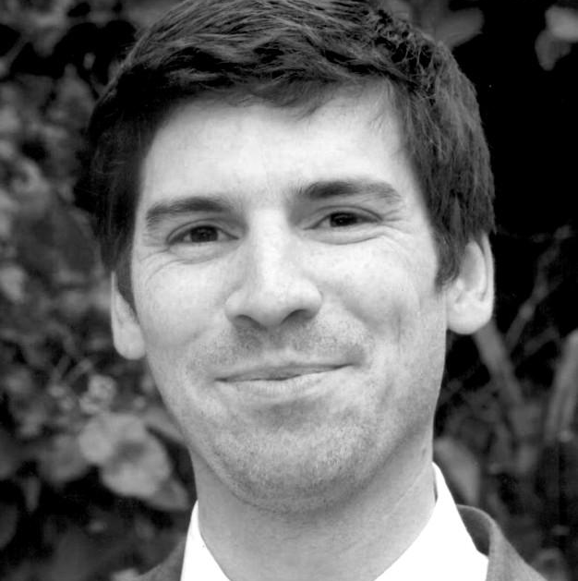
Creative Applications of Music Information Research
Matthew Davies INESC TEC

Slide 11
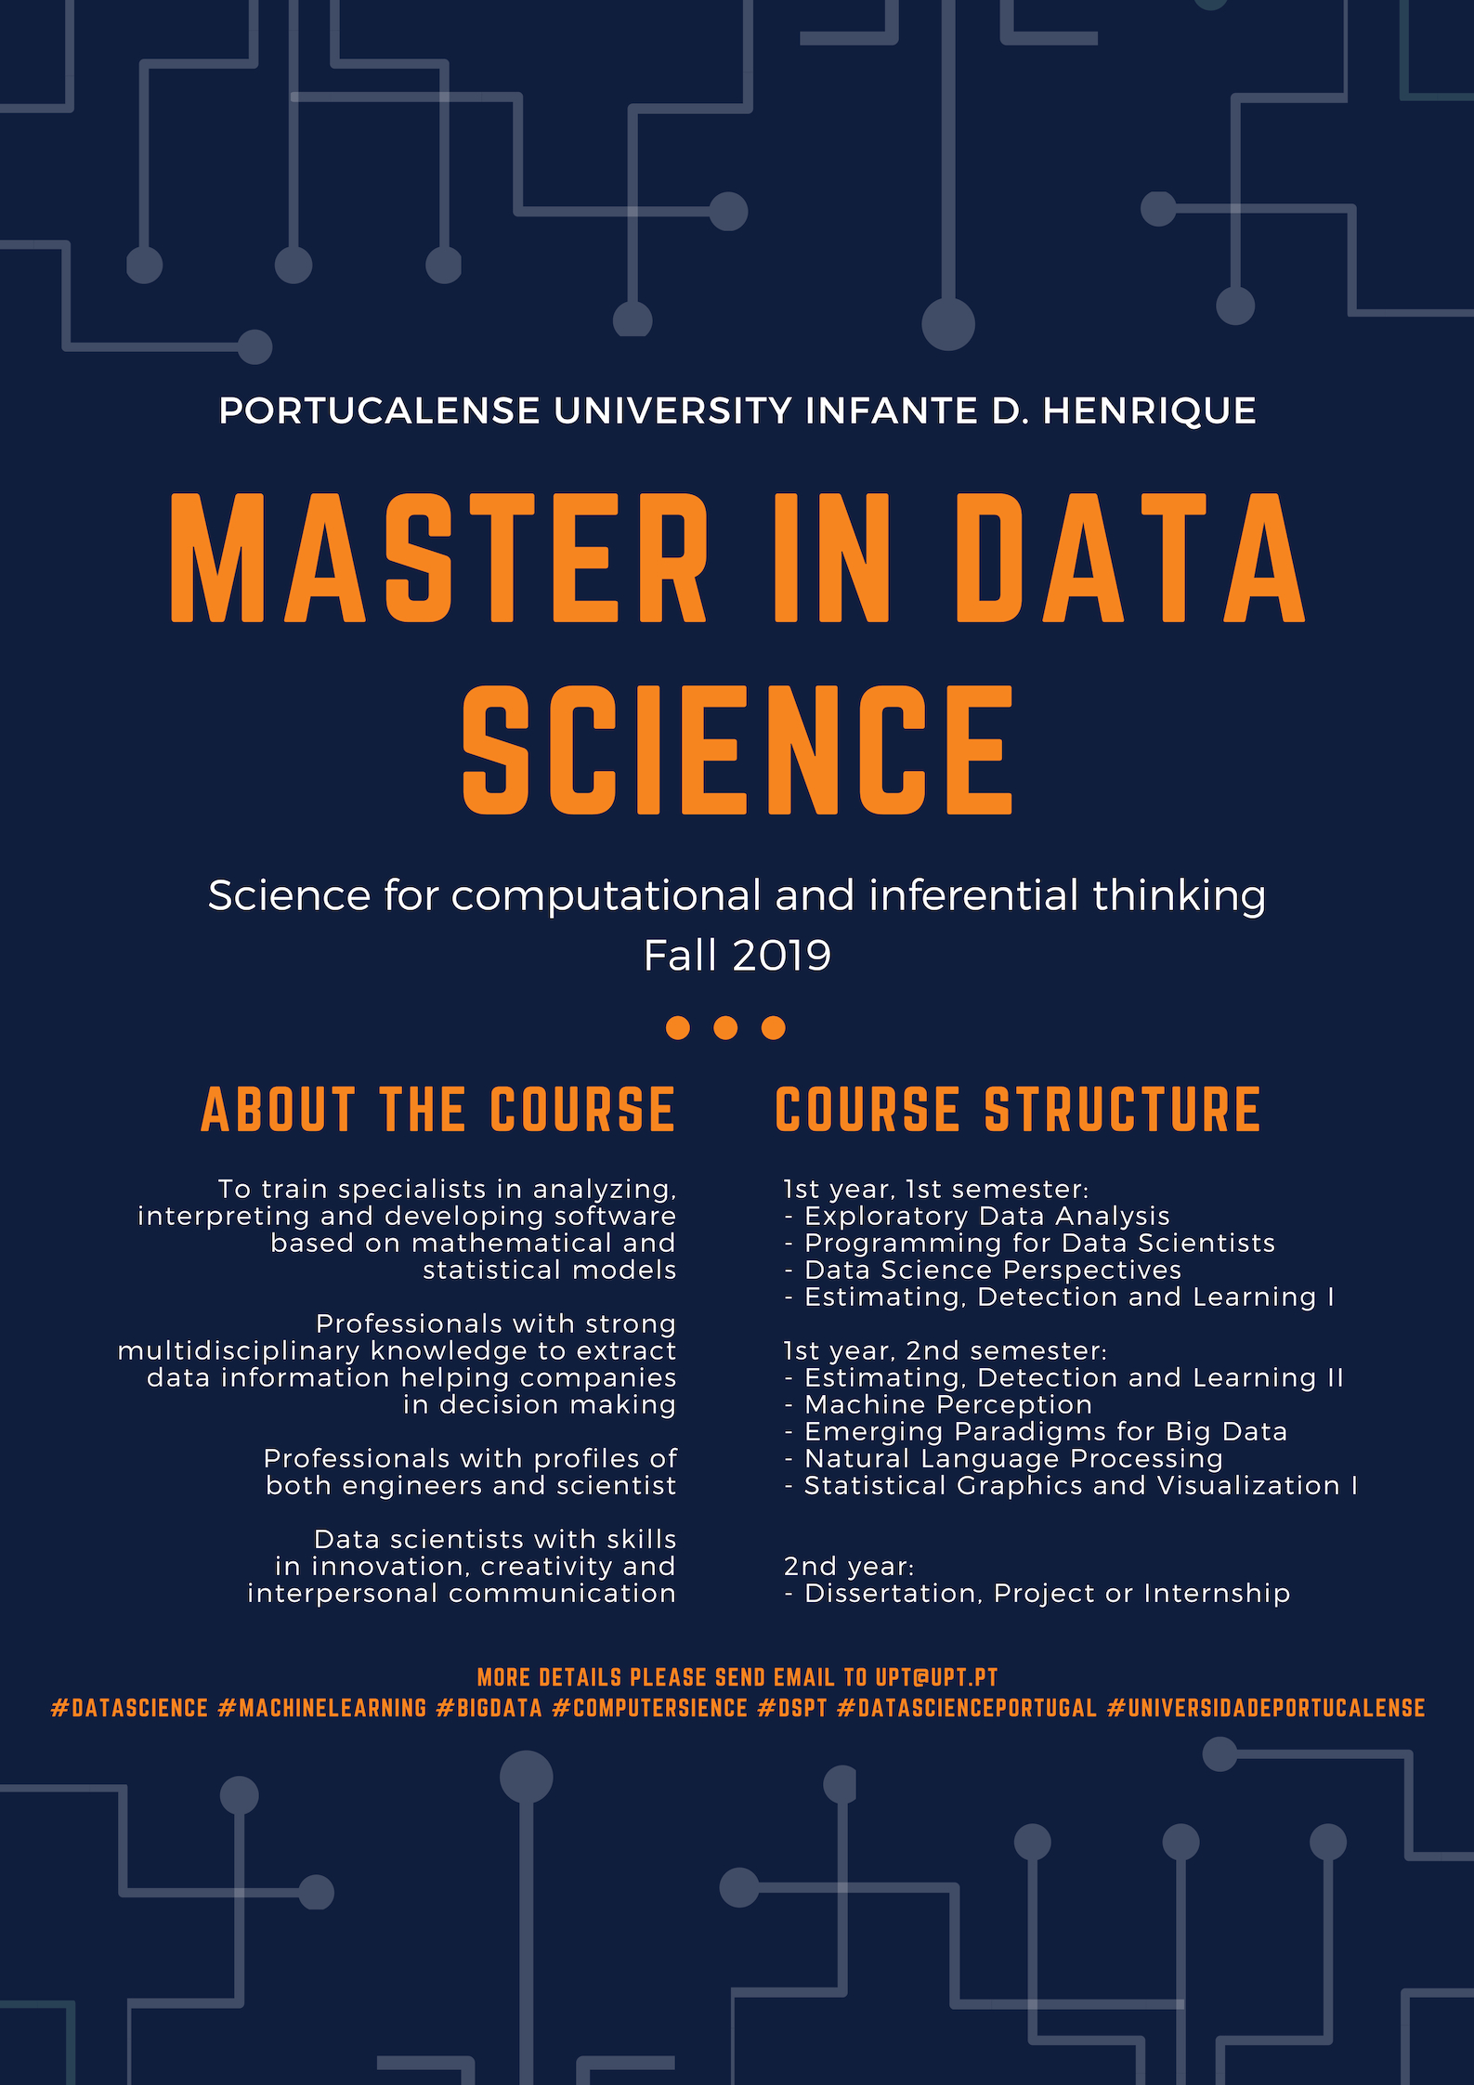

Slide 12


Networking / Beer Break
Sponsored by
Beer and Networking?
Not such a bad match!
‹#›
Notes:
Thank you Bosch and Feedzai for the coffee break for today

Slide 13
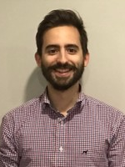
Big (Unlabeled) Data: a quest to create a fish detection dataset
Pedro Costa - Abyssal
‹#›

Slide 14
Next Scheduled Meetups
LISBOA
LISBOA
Notes:
Braga - october 11
Aveiro - october 17

Slide 15

Thank you!
datascienceportugal.com
info@datascienceportugal.com
Notes:
And that’s it for today’s event! Now some of us will go have dinner together, and if you want to join, just feel free to stick around. Thank you.

